Slide 1
Lecture 17 Abstract Data Type Stack and Queue (Linked-list-based Implementation]

Slide 2
Stack
Array based implementation
Static / dynamic array can be used
In either case, you need to anticipate the size of stack before you use it
What if you could have a stack of unlimited size (or at least the maximum your RAM can support)?

Slide 3
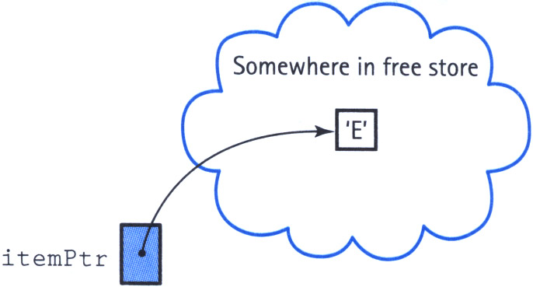
Stack
The elements in the stack now require to be dynamically allocated
// Allocate space for new item.
char *itemPtr = new char;
*itemPtr = ‘E’;

Slide 4
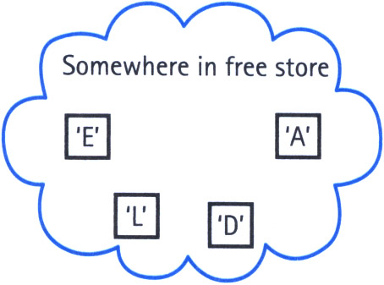
Stack
But we are going to have multiple elements in the stack
One pointer for each of the elements allocated dynamically
How do we store these pointers?

Slide 5
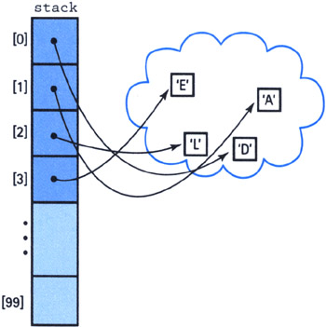
Stack
An array for all these pointers???

Slide 6
Stack
An array for all these pointers???
This array can be dynamically allocated too
Still we need to know the size of this array beforehand

Slide 7
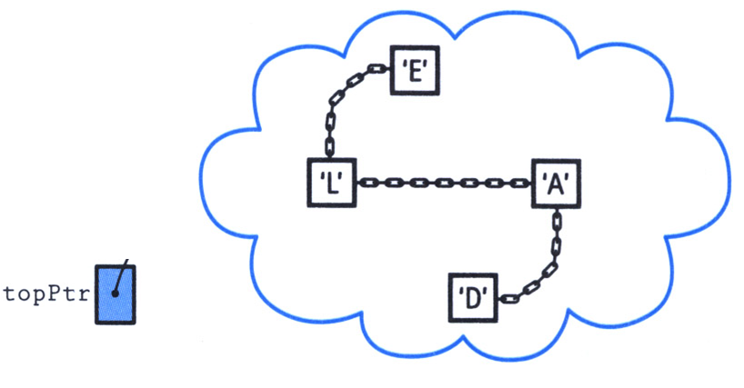
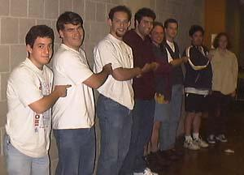
Stack
A better solution is chaining the elements one after another
We do not need to know the size of the stack anymore. All we need is the top pointer.

Slide 8

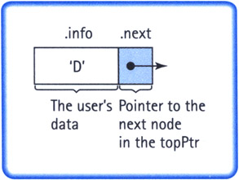
Stack Implemented as Linked-List
template <class ItemType>
struct NodeType
{
ItemType info;
NodeType* next;
};

Slide 9
Stack Implemented as Linked-List
template <class ItemType>
struct NodeType
{
ItemType info;
NodeType* next;
};
NodeType<char> node, *nodePtr;
nodePtr = new NodeType<char>;
node.info = ‘D’;
nodePtr->info = ‘L’;

Slide 10
stacktype.h
#ifndef STACKTYPE_H_INCLUDED
#define STACKTYPE_H_INCLUDED
class FullStack
// Exception class used by Push when stack is full.
{};
class EmptyStack
// Exception class used by Pop and Top when stack is empty.
{};
template <class ItemType>
class StackType
{
struct NodeType
{
ItemType info;
NodeType* next;
};
public:
StackType();
~StackType();
void Push(ItemType);
void Pop();
ItemType Top();
bool IsEmpty();
bool IsFull();
private:
NodeType<ItemType>* topPtr;
};
#endif // STACKTYPE_H_INCLUDED

Slide 11
stacktype.cpp
template <class ItemType>
StackType<ItemType>::StackType()
{
topPtr = NULL;
}
template <class ItemType>
bool StackType<ItemType>::IsEmpty()
{
return (topPtr == NULL);
}
template <class ItemType>
ItemType StackType<ItemType>::Top()
{
if (IsEmpty())
throw EmptyStack();
else
return topPtr->info;
}

Slide 12
stacktype.cpp
template <class ItemType>
StackType<ItemType>::StackType()
{
topPtr = NULL;
}
template <class ItemType>
bool StackType<ItemType>::IsEmpty()
{
return (topPtr == NULL);
}
template <class ItemType>
ItemType StackType<ItemType>::Top()
{
if (IsEmpty())
throw EmptyStack();
else
return topPtr->info;
}
O(1)
O(1)
O(1)

Slide 13
stacktype.cpp
template <class ItemType>
bool StackType<ItemType>::IsFull()
{
NodeType* location;
try
{
location = new NodeType;
delete location;
return false;
}
catch(std::bad_alloc& exception)
{
return true;
}
}

Slide 14
stacktype.cpp
template <class ItemType>
bool StackType<ItemType>::IsFull()
{
NodeType* location;
try
{
location = new NodeType;
delete location;
return false;
}
catch(std::bad_alloc& exception)
{
return true;
}
}
O(1)

Slide 15
stacktype.cpp
template <class ItemType>
void StackType<ItemType>::Push(ItemType newItem)
{
if (IsFull())
throw FullStack();
else
{
NodeType* location;
location = new NodeType;
location->info = newItem;
location->next = topPtr;
topPtr = location;
}
}

Slide 16
stacktype.cpp
template <class ItemType>
void StackType<ItemType>::Push(ItemType newItem)
{
if (IsFull())
throw FullStack();
else
{
NodeType* location;
location = new NodeType;
location->info = newItem;
location->next = topPtr;
topPtr = location;
}
}
push(‘A’);
topPtr

Slide 17
stacktype.cpp
template <class ItemType>
void StackType<ItemType>::Push(ItemType newItem)
{
if (IsFull())
throw FullStack();
else
{
NodeType* location;
location = new NodeType;
location->info = newItem;
location->next = topPtr;
topPtr = location;
}
}
push(‘A’);
location
topPtr

Slide 18
stacktype.cpp
template <class ItemType>
void StackType<ItemType>::Push(ItemType newItem)
{
if (IsFull())
throw FullStack();
else
{
NodeType* location;
location = new NodeType;
location->info = newItem;
location->next = topPtr;
topPtr = location;
}
}
push(‘A’);
location
topPtr
A

Slide 19
stacktype.cpp
template <class ItemType>
void StackType<ItemType>::Push(ItemType newItem)
{
if (IsFull())
throw FullStack();
else
{
NodeType* location;
location = new NodeType;
location->info = newItem;
location->next = topPtr;
topPtr = location;
}
}
push(‘A’);
location
topPtr
A

Slide 20
stacktype.cpp
template <class ItemType>
void StackType<ItemType>::Push(ItemType newItem)
{
if (IsFull())
throw FullStack();
else
{
NodeType* location;
location = new NodeType;
location->info = newItem;
location->next = topPtr;
topPtr = location;
}
}
topPtr
A

Slide 21
stacktype.cpp
template <class ItemType>
void StackType<ItemType>::Push(ItemType newItem)
{
if (IsFull())
throw FullStack();
else
{
NodeType* location;
location = new NodeType;
location->info = newItem;
location->next = topPtr;
topPtr = location;
}
}
push(‘B’);
topPtr
A

Slide 22
stacktype.cpp
template <class ItemType>
void StackType<ItemType>::Push(ItemType newItem)
{
if (IsFull())
throw FullStack();
else
{
NodeType* location;
location = new NodeType;
location->info = newItem;
location->next = topPtr;
topPtr = location;
}
}
push(‘B’);
location
topPtr
A

Slide 23
stacktype.cpp
template <class ItemType>
void StackType<ItemType>::Push(ItemType newItem)
{
if (IsFull())
throw FullStack();
else
{
NodeType* location;
location = new NodeType;
location->info = newItem;
location->next = topPtr;
topPtr = location;
}
}
push(‘B’);
location
B
topPtr
A

Slide 24
stacktype.cpp
template <class ItemType>
void StackType<ItemType>::Push(ItemType newItem)
{
if (IsFull())
throw FullStack();
else
{
NodeType* location;
location = new NodeType;
location->info = newItem;
location->next = topPtr;
topPtr = location;
}
}
push(‘B’);
location
B
topPtr
A

Slide 25
stacktype.cpp
template <class ItemType>
void StackType<ItemType>::Push(ItemType newItem)
{
if (IsFull())
throw FullStack();
else
{
NodeType* location;
location = new NodeType;
location->info = newItem;
location->next = topPtr;
topPtr = location;
}
}
B
topPtr
A

Slide 26
stacktype.cpp
template <class ItemType>
void StackType<ItemType>::Push(ItemType newItem)
{
if (IsFull())
throw FullStack();
else
{
NodeType* location;
location = new NodeType;
location->info = newItem;
location->next = topPtr;
topPtr = location;
}
}
O(1)

Slide 27
stacktype.cpp
template <class ItemType>
void StackType<ItemType>::Pop()
{
if (IsEmpty())
throw EmptyStack();
else
{
NodeType* tempPtr;
tempPtr = topPtr;
topPtr = topPtr->next;
delete tempPtr;
}
}

Slide 28
stacktype.cpp
template <class ItemType>
void StackType<ItemType>::Pop()
{
if (IsEmpty())
throw EmptyStack();
else
{
NodeType* tempPtr;
tempPtr = topPtr;
topPtr = topPtr->next;
delete tempPtr;
}
}
pop();
B
topPtr
A

Slide 29
stacktype.cpp
template <class ItemType>
void StackType<ItemType>::Pop()
{
if (IsEmpty())
throw EmptyStack();
else
{
NodeType* tempPtr;
tempPtr = topPtr;
topPtr = topPtr->next;
delete tempPtr;
}
}
pop();
tempPtr
B
topPtr
A

Slide 30
stacktype.cpp
template <class ItemType>
void StackType<ItemType>::Pop()
{
if (IsEmpty())
throw EmptyStack();
else
{
NodeType* tempPtr;
tempPtr = topPtr;
topPtr = topPtr->next;
delete tempPtr;
}
}
pop();
tempPtr
B
topPtr
A

Slide 31
stacktype.cpp
template <class ItemType>
void StackType<ItemType>::Pop()
{
if (IsEmpty())
throw EmptyStack();
else
{
NodeType* tempPtr;
tempPtr = topPtr;
topPtr = topPtr->next;
delete tempPtr;
}
}
pop();
tempPtr
topPtr
A

Slide 32
stacktype.cpp
template <class ItemType>
void StackType<ItemType>::Pop()
{
if (IsEmpty())
throw EmptyStack();
else
{
NodeType* tempPtr;
tempPtr = topPtr;
topPtr = topPtr->next;
delete tempPtr;
}
}
topPtr
A

Slide 33
stacktype.cpp
template <class ItemType>
void StackType<ItemType>::Pop()
{
if (IsEmpty())
throw EmptyStack();
else
{
NodeType* tempPtr;
tempPtr = topPtr;
topPtr = topPtr->next;
delete tempPtr;
}
}
pop();
topPtr
A

Slide 34
stacktype.cpp
template <class ItemType>
void StackType<ItemType>::Pop()
{
if (IsEmpty())
throw EmptyStack();
else
{
NodeType* tempPtr;
tempPtr = topPtr;
topPtr = topPtr->next;
delete tempPtr;
}
}
pop();
tempPtr
topPtr
A

Slide 35
stacktype.cpp
template <class ItemType>
void StackType<ItemType>::Pop()
{
if (IsEmpty())
throw EmptyStack();
else
{
NodeType* tempPtr;
tempPtr = topPtr;
topPtr = topPtr->next;
delete tempPtr;
}
}
pop();
tempPtr
topPtr
A

Slide 36
stacktype.cpp
template <class ItemType>
void StackType<ItemType>::Pop()
{
if (IsEmpty())
throw EmptyStack();
else
{
NodeType* tempPtr;
tempPtr = topPtr;
topPtr = topPtr->next;
delete tempPtr;
}
}
pop();
tempPtr
topPtr

Slide 37
stacktype.cpp
template <class ItemType>
void StackType<ItemType>::Pop()
{
if (IsEmpty())
throw EmptyStack();
else
{
NodeType* tempPtr;
tempPtr = topPtr;
topPtr = topPtr->next;
delete tempPtr;
}
}
topPtr

Slide 38
stacktype.cpp
template <class ItemType>
void StackType<ItemType>::Pop()
{
if (IsEmpty())
throw EmptyStack();
else
{
NodeType* tempPtr;
tempPtr = topPtr;
topPtr = topPtr->next;
delete tempPtr;
}
}
O(1)

Slide 39
stacktype.cpp
template <class ItemType>
StackType<ItemType>::~StackType()
{
NodeType* tempPtr;
while (topPtr != NULL)
{
tempPtr = topPtr;
topPtr = topPtr->next;
delete tempPtr;
}
}

Slide 40
stacktype.cpp
template <class ItemType>
StackType<ItemType>::~StackType()
{
NodeType* tempPtr;
while (topPtr != NULL)
{
tempPtr = topPtr;
topPtr = topPtr->next;
delete tempPtr;
}
}
O(N)

Slide 41
Queue
Array based implementation
Just like stack, you need to anticipate the size of queue beforehand
No way to change its size during program execution
Linked list based implementation
The queue grows and shrinks on demand

Slide 42
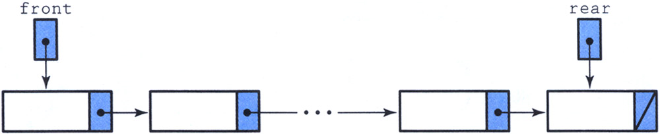
Queue Implemented as Linked-List
template <class ItemType>
struct NodeType
{
ItemType info;
NodeType* next;
};

Slide 43
queuetype.h
#ifndef QUEUETYPE_H_INCLUDED
#define QUEUETYPE_H_INCLUDED
class FullQueue
// Exception class used by Push when queue is full.
{};
class EmptyQueue
// Exception class used by Pop and Top when queue is empty.
{};
template <class ItemType>
class QueType
{
struct NodeType
{
ItemType info;
NodeType* next;
};
public:
QueType();
~QueType();
void MakeEmpty();
void Enqueue(ItemType);
void Dequeue(ItemType&);
bool IsEmpty();
bool IsFull();
private:
NodeType<ItemType>* front;
NodeType<ItemType>* rear;
};
#endif // QUEUETYPE_H_INCLUDED

Slide 44
queuetype.cpp
template <class ItemType>
QueType<ItemType>::QueType()
{
front = NULL;
rear = NULL;
}
template <class ItemType>
bool QueType<ItemType>::IsEmpty()
{
return (front == NULL);
}
template<class ItemType>
bool QueType<ItemType>::IsFull()
{
NodeType* location;
try
{
location = new NodeType;
delete location;
return false;
}
catch(std::bad_alloc& exception)
{
return true;
}
}

Slide 45
queuetype.cpp
template <class ItemType>
QueType<ItemType>::QueType()
{
front = NULL;
rear = NULL;
}
template <class ItemType>
bool QueType<ItemType>::IsEmpty()
{
return (front == NULL);
}
template<class ItemType>
bool QueType<ItemType>::IsFull()
{
NodeType* location;
try
{
location = new NodeType;
delete location;
return false;
}
catch(std::bad_alloc& exception)
{
return true;
}
}
O(1)
O(1)
O(1)

Slide 46
queuetype.cpp
template <class ItemType>
void QueType<ItemType>::Enqueue(ItemType newItem)
{
if (IsFull())
throw FullQueue();
else
{
NodeType* newNode;
newNode = new NodeType;
newNode->info = newItem;
newNode->next = NULL;
if (rear == NULL)
front = newNode;
else
rear->next = newNode;
rear = newNode;
}
}

Slide 47
queuetype.cpp
template <class ItemType>
void QueType<ItemType>::Enqueue(ItemType newItem)
{
if (IsFull())
throw FullQueue();
else
{
NodeType* newNode;
newNode = new NodeType;
newNode->info = newItem;
newNode->next = NULL;
if (rear == NULL)
front = newNode;
else
rear->next = newNode;
rear = newNode;
}
}
front
rear
Enqueue(‘A’)

Slide 48
queuetype.cpp
template <class ItemType>
void QueType<ItemType>::Enqueue(ItemType newItem)
{
if (IsFull())
throw FullQueue();
else
{
NodeType* newNode;
newNode = new NodeType;
newNode->info = newItem;
newNode->next = NULL;
if (rear == NULL)
front = newNode;
else
rear->next = newNode;
rear = newNode;
}
}
front
rear
newNode
Enqueue(‘A’)

Slide 49
queuetype.cpp
template <class ItemType>
void QueType<ItemType>::Enqueue(ItemType newItem)
{
if (IsFull())
throw FullQueue();
else
{
NodeType* newNode;
newNode = new NodeType;
newNode->info = newItem;
newNode->next = NULL;
if (rear == NULL)
front = newNode;
else
rear->next = newNode;
rear = newNode;
}
}
front
A
rear
newNode
Enqueue(‘A’)

Slide 50
queuetype.cpp
template <class ItemType>
void QueType<ItemType>::Enqueue(ItemType newItem)
{
if (IsFull())
throw FullQueue();
else
{
NodeType* newNode;
newNode = new NodeType;
newNode->info = newItem;
newNode->next = NULL;
if (rear == NULL)
front = newNode;
else
rear->next = newNode;
rear = newNode;
}
}
front
A
rear
newNode
Enqueue(‘A’)

Slide 51
queuetype.cpp
template <class ItemType>
void QueType<ItemType>::Enqueue(ItemType newItem)
{
if (IsFull())
throw FullQueue();
else
{
NodeType* newNode;
newNode = new NodeType;
newNode->info = newItem;
newNode->next = NULL;
if (rear == NULL)
front = newNode;
else
rear->next = newNode;
rear = newNode;
}
}
front
A
rear
newNode
Enqueue(‘A’)

Slide 52
queuetype.cpp
template <class ItemType>
void QueType<ItemType>::Enqueue(ItemType newItem)
{
if (IsFull())
throw FullQueue();
else
{
NodeType* newNode;
newNode = new NodeType;
newNode->info = newItem;
newNode->next = NULL;
if (rear == NULL)
front = newNode;
else
rear->next = newNode;
rear = newNode;
}
}
front
A
rear

Slide 53
queuetype.cpp
template <class ItemType>
void QueType<ItemType>::Enqueue(ItemType newItem)
{
if (IsFull())
throw FullQueue();
else
{
NodeType* newNode;
newNode = new NodeType;
newNode->info = newItem;
newNode->next = NULL;
if (rear == NULL)
front = newNode;
else
rear->next = newNode;
rear = newNode;
}
}
front
A
rear
Enqueue(‘B’)

Slide 54
queuetype.cpp
template <class ItemType>
void QueType<ItemType>::Enqueue(ItemType newItem)
{
if (IsFull())
throw FullQueue();
else
{
NodeType* newNode;
newNode = new NodeType;
newNode->info = newItem;
newNode->next = NULL;
if (rear == NULL)
front = newNode;
else
rear->next = newNode;
rear = newNode;
}
}
front
A
rear
newNode
Enqueue(‘B’)

Slide 55
queuetype.cpp
template <class ItemType>
void QueType<ItemType>::Enqueue(ItemType newItem)
{
if (IsFull())
throw FullQueue();
else
{
NodeType* newNode;
newNode = new NodeType;
newNode->info = newItem;
newNode->next = NULL;
if (rear == NULL)
front = newNode;
else
rear->next = newNode;
rear = newNode;
}
}
front
A
rear
B
newNode
Enqueue(‘B’)

Slide 56
queuetype.cpp
template <class ItemType>
void QueType<ItemType>::Enqueue(ItemType newItem)
{
if (IsFull())
throw FullQueue();
else
{
NodeType* newNode;
newNode = new NodeType;
newNode->info = newItem;
newNode->next = NULL;
if (rear == NULL)
front = newNode;
else
rear->next = newNode;
rear = newNode;
}
}
front
A
rear
B
newNode
Enqueue(‘B’)

Slide 57
queuetype.cpp
template <class ItemType>
void QueType<ItemType>::Enqueue(ItemType newItem)
{
if (IsFull())
throw FullQueue();
else
{
NodeType* newNode;
newNode = new NodeType;
newNode->info = newItem;
newNode->next = NULL;
if (rear == NULL)
front = newNode;
else
rear->next = newNode;
rear = newNode;
}
}
front
A
rear
B
newNode
Enqueue(‘B’)

Slide 58
queuetype.cpp
template <class ItemType>
void QueType<ItemType>::Enqueue(ItemType newItem)
{
if (IsFull())
throw FullQueue();
else
{
NodeType* newNode;
newNode = new NodeType;
newNode->info = newItem;
newNode->next = NULL;
if (rear == NULL)
front = newNode;
else
rear->next = newNode;
rear = newNode;
}
}
front
A
rear
B

Slide 59
queuetype.cpp
template <class ItemType>
void QueType<ItemType>::Enqueue(ItemType newItem)
{
if (IsFull())
throw FullQueue();
else
{
NodeType* newNode;
newNode = new NodeType;
newNode->info = newItem;
newNode->next = NULL;
if (rear == NULL)
front = newNode;
else
rear->next = newNode;
rear = newNode;
}
}
front
A
rear
B
Enqueue(‘C’)

Slide 60
queuetype.cpp
template <class ItemType>
void QueType<ItemType>::Enqueue(ItemType newItem)
{
if (IsFull())
throw FullQueue();
else
{
NodeType* newNode;
newNode = new NodeType;
newNode->info = newItem;
newNode->next = NULL;
if (rear == NULL)
front = newNode;
else
rear->next = newNode;
rear = newNode;
}
}
front
A
rear
B
newNode
Enqueue(‘C’)

Slide 61
queuetype.cpp
template <class ItemType>
void QueType<ItemType>::Enqueue(ItemType newItem)
{
if (IsFull())
throw FullQueue();
else
{
NodeType* newNode;
newNode = new NodeType;
newNode->info = newItem;
newNode->next = NULL;
if (rear == NULL)
front = newNode;
else
rear->next = newNode;
rear = newNode;
}
}
front
A
rear
B
C
newNode
Enqueue(‘C’)

Slide 62
queuetype.cpp
template <class ItemType>
void QueType<ItemType>::Enqueue(ItemType newItem)
{
if (IsFull())
throw FullQueue();
else
{
NodeType* newNode;
newNode = new NodeType;
newNode->info = newItem;
newNode->next = NULL;
if (rear == NULL)
front = newNode;
else
rear->next = newNode;
rear = newNode;
}
}
front
A
rear
B
C
newNode
Enqueue(‘C’)

Slide 63
queuetype.cpp
template <class ItemType>
void QueType<ItemType>::Enqueue(ItemType newItem)
{
if (IsFull())
throw FullQueue();
else
{
NodeType* newNode;
newNode = new NodeType;
newNode->info = newItem;
newNode->next = NULL;
if (rear == NULL)
front = newNode;
else
rear->next = newNode;
rear = newNode;
}
}
front
A
B
rear
C
newNode
Enqueue(‘C’)

Slide 64
queuetype.cpp
template <class ItemType>
void QueType<ItemType>::Enqueue(ItemType newItem)
{
if (IsFull())
throw FullQueue();
else
{
NodeType* newNode;
newNode = new NodeType;
newNode->info = newItem;
newNode->next = NULL;
if (rear == NULL)
front = newNode;
else
rear->next = newNode;
rear = newNode;
}
}
front
A
B
rear
C

Slide 65
queuetype.cpp
template <class ItemType>
void QueType<ItemType>::Enqueue(ItemType newItem)
{
if (IsFull())
throw FullQueue();
else
{
NodeType* newNode;
newNode = new NodeType;
newNode->info = newItem;
newNode->next = NULL;
if (rear == NULL)
front = newNode;
else
rear->next = newNode;
rear = newNode;
}
}
O(1)

Slide 66
queuetype.cpp
template <class ItemType>
void QueType<ItemType>::Dequeue(ItemType& item)
{
if (IsEmpty())
throw EmptyQueue();
else
{
NodeType* tempPtr;
tempPtr = front;
item = front->info;
front = front->next;
if (front == NULL)
rear = NULL;
delete tempPtr;
}
}

Slide 67
queuetype.cpp
template <class ItemType>
void QueType<ItemType>::Dequeue(ItemType& item)
{
if (IsEmpty())
throw EmptyQueue();
else
{
NodeType* tempPtr;
tempPtr = front;
item = front->info;
front = front->next;
if (front == NULL)
rear = NULL;
delete tempPtr;
}
}
front
A
B
rear
C
Dequeue()

Slide 68
queuetype.cpp
template <class ItemType>
void QueType<ItemType>::Dequeue(ItemType& item)
{
if (IsEmpty())
throw EmptyQueue();
else
{
NodeType* tempPtr;
tempPtr = front;
item = front->info;
front = front->next;
if (front == NULL)
rear = NULL;
delete tempPtr;
}
}
tempPtr
front
A
B
rear
C
Dequeue()

Slide 69
queuetype.cpp
template <class ItemType>
void QueType<ItemType>::Dequeue(ItemType& item)
{
if (IsEmpty())
throw EmptyQueue();
else
{
NodeType* tempPtr;
tempPtr = front;
item = front->info;
front = front->next;
if (front == NULL)
rear = NULL;
delete tempPtr;
}
}
tempPtr
A
front
B
rear
C
Dequeue()

Slide 70
queuetype.cpp
template <class ItemType>
void QueType<ItemType>::Dequeue(ItemType& item)
{
if (IsEmpty())
throw EmptyQueue();
else
{
NodeType* tempPtr;
tempPtr = front;
item = front->info;
front = front->next;
if (front == NULL)
rear = NULL;
delete tempPtr;
}
}
tempPtr
front
B
rear
C
Dequeue()

Slide 71
queuetype.cpp
template <class ItemType>
void QueType<ItemType>::Dequeue(ItemType& item)
{
if (IsEmpty())
throw EmptyQueue();
else
{
NodeType* tempPtr;
tempPtr = front;
item = front->info;
front = front->next;
if (front == NULL)
rear = NULL;
delete tempPtr;
}
}
front
B
rear
C

Slide 72
queuetype.cpp
template <class ItemType>
void QueType<ItemType>::Dequeue(ItemType& item)
{
if (IsEmpty())
throw EmptyQueue();
else
{
NodeType* tempPtr;
tempPtr = front;
item = front->info;
front = front->next;
if (front == NULL)
rear = NULL;
delete tempPtr;
}
}
front
B
rear
C
Dequeue()

Slide 73
queuetype.cpp
template <class ItemType>
void QueType<ItemType>::Dequeue(ItemType& item)
{
if (IsEmpty())
throw EmptyQueue();
else
{
NodeType* tempPtr;
tempPtr = front;
item = front->info;
front = front->next;
if (front == NULL)
rear = NULL;
delete tempPtr;
}
}
tempPtr
front
B
rear
C
Dequeue()

Slide 74
queuetype.cpp
template <class ItemType>
void QueType<ItemType>::Dequeue(ItemType& item)
{
if (IsEmpty())
throw EmptyQueue();
else
{
NodeType* tempPtr;
tempPtr = front;
item = front->info;
front = front->next;
if (front == NULL)
rear = NULL;
delete tempPtr;
}
}
tempPtr
front
B
rear
C
Dequeue()

Slide 75
queuetype.cpp
template <class ItemType>
void QueType<ItemType>::Dequeue(ItemType& item)
{
if (IsEmpty())
throw EmptyQueue();
else
{
NodeType* tempPtr;
tempPtr = front;
item = front->info;
front = front->next;
if (front == NULL)
rear = NULL;
delete tempPtr;
}
}
tempPtr
front
rear
C
Dequeue()

Slide 76
queuetype.cpp
template <class ItemType>
void QueType<ItemType>::Dequeue(ItemType& item)
{
if (IsEmpty())
throw EmptyQueue();
else
{
NodeType* tempPtr;
tempPtr = front;
item = front->info;
front = front->next;
if (front == NULL)
rear = NULL;
delete tempPtr;
}
}
front
rear
C

Slide 77
queuetype.cpp
template <class ItemType>
void QueType<ItemType>::Dequeue(ItemType& item)
{
if (IsEmpty())
throw EmptyQueue();
else
{
NodeType* tempPtr;
tempPtr = front;
item = front->info;
front = front->next;
if (front == NULL)
rear = NULL;
delete tempPtr;
}
}
front
rear
C
Dequeue()

Slide 78
queuetype.cpp
template <class ItemType>
void QueType<ItemType>::Dequeue(ItemType& item)
{
if (IsEmpty())
throw EmptyQueue();
else
{
NodeType* tempPtr;
tempPtr = front;
item = front->info;
front = front->next;
if (front == NULL)
rear = NULL;
delete tempPtr;
}
}
tempPtr
front
rear
C
Dequeue()

Slide 79
queuetype.cpp
template <class ItemType>
void QueType<ItemType>::Dequeue(ItemType& item)
{
if (IsEmpty())
throw EmptyQueue();
else
{
NodeType* tempPtr;
tempPtr = front;
item = front->info;
front = front->next;
if (front == NULL)
rear = NULL;
delete tempPtr;
}
}
tempPtr
front
rear
C
Dequeue()

Slide 80
queuetype.cpp
template <class ItemType>
void QueType<ItemType>::Dequeue(ItemType& item)
{
if (IsEmpty())
throw EmptyQueue();
else
{
NodeType* tempPtr;
tempPtr = front;
item = front->info;
front = front->next;
if (front == NULL)
rear = NULL;
delete tempPtr;
}
}
tempPtr
front
rear
C
Dequeue()

Slide 81
queuetype.cpp
template <class ItemType>
void QueType<ItemType>::Dequeue(ItemType& item)
{
if (IsEmpty())
throw EmptyQueue();
else
{
NodeType* tempPtr;
tempPtr = front;
item = front->info;
front = front->next;
if (front == NULL)
rear = NULL;
delete tempPtr;
}
}
tempPtr
front
rear
Dequeue()

Slide 82
queuetype.cpp
template <class ItemType>
void QueType<ItemType>::Dequeue(ItemType& item)
{
if (IsEmpty())
throw EmptyQueue();
else
{
NodeType* tempPtr;
tempPtr = front;
item = front->info;
front = front->next;
if (front == NULL)
rear = NULL;
delete tempPtr;
}
}
front
rear

Slide 83
queuetype.cpp
template <class ItemType>
void QueType<ItemType>::Dequeue(ItemType& item)
{
if (IsEmpty())
throw EmptyQueue();
else
{
NodeType* tempPtr;
tempPtr = front;
item = front->info;
front = front->next;
if (front == NULL)
rear = NULL;
delete tempPtr;
}
}
O(1)

Slide 84
queuetype.cpp
template <class ItemType>
void QueType<ItemType>::MakeEmpty()
{
NodeType* tempPtr;
while (front != NULL)
{
tempPtr = front;
front = front->next;
delete tempPtr;
}
rear = NULL;
}
template <class ItemType>
QueType<ItemType>::~QueType()
{
MakeEmpty();
}

Slide 85
queuetype.cpp
template <class ItemType>
void QueType<ItemType>::MakeEmpty()
{
NodeType* tempPtr;
while (front != NULL)
{
tempPtr = front;
front = front->next;
delete tempPtr;
}
rear = NULL;
}
template <class ItemType>
QueType<ItemType>::~QueType()
{
MakeEmpty();
}
O(N)
O(N)

Slide 87
A Look Back at Functions
#include <stdio.h>
#include <math.h>
double distance(double x1, double y1, double x2, double y2)
{
double dist;
dist = sqrt((x1-x2)*(x1-x2)+(y1-y2)*(y1-y2));
return dist;
}
int main()
{
double milage = distance(0, 0, 3, 4);
printf("Milage: %lf\n",milage);
return 0;
}

Slide 88
A Look Back at Functions
#include <stdio.h>
#include <math.h>
double distance(double x1, double y1, double x2, double y2)
{
double dist;
dist = sqrt((x1-x2)*(x1-x2)+(y1-y2)*(y1-y2));
return dist;
}
int main()
{
double milage = distance(0, 0, 3, 4);
printf("Milage: %lf\n",milage);
return 0;
}
main

Slide 89
A Look Back at Functions
#include <stdio.h>
#include <math.h>
double distance(double x1, double y1, double x2, double y2)
{
double dist;
dist = sqrt((x1-x2)*(x1-x2)+(y1-y2)*(y1-y2));
return dist;
}
int main()
{
double milage = distance(0, 0, 3, 4);
printf("Milage: %lf\n",milage);
return 0;
}
main
distance
(0,0,3,4)

Slide 90
A Look Back at Functions
#include <stdio.h>
#include <math.h>
double distance(double x1, double y1, double x2, double y2)
{
double dist;
dist = sqrt((x1-x2)*(x1-x2)+(y1-y2)*(y1-y2));
return dist;
}
int main()
{
double milage = distance(0, 0, 3, 4);
printf("Milage: %lf\n",milage);
return 0;
}
main
distance
sqrt
(0,0,3,4)
(25)

Slide 91
A Look Back at Functions
#include <stdio.h>
#include <math.h>
double distance(double x1, double y1, double x2, double y2)
{
double dist;
dist = sqrt((x1-x2)*(x1-x2)+(y1-y2)*(y1-y2));
return dist;
}
int main()
{
double milage = distance(0, 0, 3, 4);
printf("Milage: %lf\n",milage);
return 0;
}
(5)
main
distance
sqrt
(0,0,3,4)
(25)

Slide 92
A Look Back at Functions
#include <stdio.h>
#include <math.h>
double distance(double x1, double y1, double x2, double y2)
{
double dist;
dist = sqrt((x1-x2)*(x1-x2)+(y1-y2)*(y1-y2));
return dist;
}
int main()
{
double milage = distance(0, 0, 3, 4);
printf("Milage: %lf\n",milage);
return 0;
}
(5)
main
distance
(0,0,3,4)

Slide 93
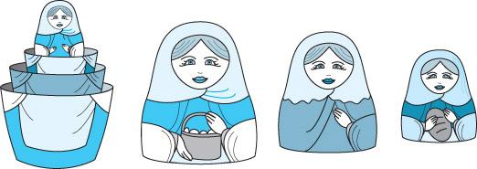
Recursion
Recursion is a technique that solves a problem by solving a smaller problem of the same type.
Recursion can be implemented using a recursive function (a function invoking itself, either directly or indirectly).
Recursion can be used as an alternative to iteration.
It is an important and powerful tool in problem solving and programming.
It is a programming technique that naturally implements the divide-and-conquer problem solving methodology.

Slide 94
The Nature of Recursion
One or more simple cases of the problem (called the stopping cases or base case) have a simple non-recursive solution.
The other cases (general cases) of the problem can be reduced (using recursion) to problems that are closer to stopping cases.
Eventually the problem can be reduced to base cases only, which are relatively easy to solve.
In general:
if (base case)
solve it
else
reduce the problem using recursion // general case

Slide 95
Factorial of 4 (Recursive)
Calculate 4!
4! = 4 * (4-1)!
4! = 4 * 3!
4! = 4 * __

Slide 96
Factorial of 4 (Recursive)
Calculate 4!
4! = 4 * (4-1)!
4! = 4 * 3!
4! = 4 * __
Calculate 3!
3! = 3 * (3-1)!
3! = 3 * 2!
3! = 3 * __

Slide 97
Factorial of 4 (Recursive)
Calculate 4!
4! = 4 * (4-1)!
4! = 4 * 3!
4! = 4 * __
Calculate 3!
3! = 3 * (3-1)!
3! = 3 * 2!
3! = 3 * __
Calculate 2!
2! = 2 * (2-1)!
2! = 2 * 1!
2! = 2 * __

Slide 98
Factorial of 4 (Recursive)
Calculate 4!
4! = 4 * (4-1)!
4! = 4 * 3!
4! = 4 * __
Calculate 3!
3! = 3 * (3-1)!
3! = 3 * 2!
3! = 3 * __
Calculate 2!
2! = 2 * (2-1)!
2! = 2 * 1!
2! = 2 * __
Calculate 1!
1! = 1 * (1-1)!
1! = 1 * 0!
1! = 1 * __

Slide 99
Factorial of 4 (Recursive)
Calculate 4!
4! = 4 * (4-1)!
4! = 4 * 3!
4! = 4 * __
Calculate 3!
3! = 3 * (3-1)!
3! = 3 * 2!
3! = 3 * __
Calculate 2!
2! = 2 * (2-1)!
2! = 2 * 1!
2! = 2 * __
Calculate 1!
1! = 1 * (1-1)!
1! = 1 * 0!
1! = 1 * __
Calculate 0!
0! = 1

Slide 100
Factorial of 4 (Recursive)
Calculate 4!
4! = 4 * (4-1)!
4! = 4 * 3!
4! = 4 * __
Calculate 3!
3! = 3 * (3-1)!
3! = 3 * 2!
3! = 3 * __
Calculate 2!
2! = 2 * (2-1)!
2! = 2 * 1!
2! = 2 * __
Calculate 1!
1! = 1 * (1-1)!
1! = 1 * 0!
1! = 1 * 1
1! = 1

Slide 101
Factorial of 4 (Recursive)
Calculate 4!
4! = 4 * (4-1)!
4! = 4 * 3!
4! = 4 * __
Calculate 3!
3! = 3 * (3-1)!
3! = 3 * 2!
3! = 3 * __
Calculate 2!
2! = 2 * (2-1)!
2! = 2 * 1!
2! = 2 * 1
2! = 2

Slide 102
Factorial of 4 (Recursive)
Calculate 4!
4! = 4 * (4-1)!
4! = 4 * 3!
4! = 4 * __
Calculate 3!
3! = 3 * (3-1)!
3! = 3 * 2!
3! = 3 * 2
3! = 6

Slide 103
Factorial of 4 (Recursive)
Calculate 4!
4! = 4 * (4-1)!
4! = 4 * 3!
4! = 4 * 6
4! = 24

